Slide 1
A New Approach to Capital Markets Assumptions and Strategic Asset Allocation for US Life Insurers
Giga Nozadze
October 30, 2025

Slide 2
Using Forecast Error Instead of Volatility Leads to More Efficient Portfolios
Switching from volatility to forecast error changes optimal portfolios — less risk, better capital efficiency
Current allocations (transparent) are different from optimal weights (solid)
1

Slide 3
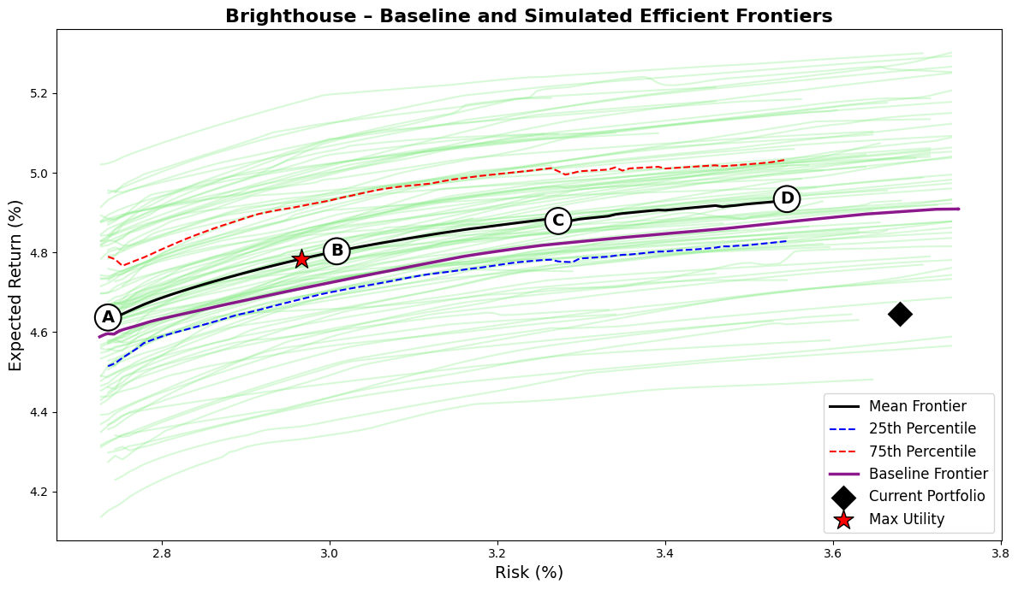
Brighthouse’s Portfolio Is Safe and Capital-Efficient But Leaves Return on the Table
Brighthouse’s current portfolio sits inside the efficient frontier, so higher return or lower risk is possible without extra capital.
Despite a disciplined setup with strong credit quality and low capital usage, the current mix underperforms both the mean and baseline efficient frontiers.
1

Slide 4
Optimized Allocation Enhances Surplus While Preserving Capital and Credit Quality
The surplus-maximizing portfolio achieves the same return with 70 bps less risk, or 15–30 bps higher return at the same risk, all without increasing capital usage or degrading credit rating.
The optimizer reallocates toward structured credit, mortgage whole loans, and private placements, top return-to-RBC assets, while trimming global corporates and HY due to weak capital efficiency.
Metric/Asset | Current | Port A | Port B | Port C | Port D | Max Utility
Expected Return (%) | 4.65 | 4.59 | 4.72 | 4.80 | 4.84 | 4.70
Risk (%) | 3.68 | 2.74 | 3.00 | 3.25 | 3.49 | 2.95
Sharpe Ratio | 0.18 | 0.22 | 0.24 | 0.25 | 0.24 | 0.24
Avg FI Credit Rating | AA- | AA- | AA- | AA- | AA- | AA-
FI Duration (years) | 6.20 | 6.35 | 6.34 | 6.35 | 6.35 | 6.34
Net Duration (years) | 0.84 | 0.99 | 0.99 | 1.00 | 1.00 | 0.99
Capital Use (%) | 1.92 | 0.60 | 0.76 | 0.83 | 0.85 | 0.74
US Treasuries, Short/Intermediate | 3.7 | 9.9 | 6.7 | 6.1 | 4.8 | 6.7
US Treasuries, Long | 2.6 | 0.0 | 0.3 | 1.1 | 1.9 | 0.2
US Taxable Munis | 3.3 | 1.2 | 0.0 | 0.0 | 0.0 | 0.0
Global ex-US Government, hedged | 0.9 | 0.0 | 0.0 | 0.0 | 0.0 | 0.0
US Public Corporates IG AAA | 3.2 | 10.0 | 10.0 | 9.7 | 9.3 | 10.0
US Public Corporates IG AA | 6.4 | 9.9 | 6.5 | 5.4 | 3.9 | 7.0
US Public Corporates IG A | 9.6 | 9.7 | 9.3 | 9.4 | 9.1 | 9.2
US Public Corporates IG BBB | 9.2 | 0.1 | 1.8 | 2.3 | 2.4 | 1.8
US Public Corporates, HY Intermediate | 0.5 | 0.0 | 0.8 | 1.1 | 1.2 | 0.7
US Public Corporates, HY Long | 0.3 | 0.0 | 2.1 | 3.2 | 3.3 | 1.7
Global ex-US Corporates, hedged | 11.1 | 10.0 | 7.4 | 2.4 | 0.6 | 8.0
Residential Mortgage-Backed Securities | 7.4 | 8.4 | 10.0 | 10.0 | 10.0 | 10.0
Commercial Mortgage-Backed Securities | 5.8 | 9.8 | 9.4 | 9.6 | 9.3 | 9.4
Asset-Backed Securities (ABS) | 5.4 | 0.6 | 4.7 | 7.0 | 7.1 | 4.3
Corporate IG Private Placement A | 4.1 | 10.0 | 10.0 | 10.0 | 10.0 | 10.0
Corporate IG Private Placement BBB | 2.0 | 10.0 | 10.0 | 10.0 | 10.0 | 10.0
Corporate HY Private (Leveraged Loans) | 0.2 | 0.1 | 0.6 | 0.4 | 0.4 | 0.6
Residential Mortgage Whole Loans | 6.7 | 10.0 | 10.0 | 10.0 | 10.0 | 10.0
Commercial Mortgage Whole Loans | 13.4 | 0.0 | 0.4 | 2.3 | 6.7 | 0.3
Private Equity | 3.6 | 0.2 | 0.0 | 0.1 | 0.0 | 0.0
Real Estate (via partnerships, equity) | 0.6 | 0.0 | 0.0 | 0.0 | 0.0 | 0.0
1

Slide 5
Starting Yield Accurately Predicts Long-Term Bond Returns Across Sectors
Across bond types, the starting yield explains most of the 10-year return, with R² values above 0.85 and slopes near 1.
This reinforces the case for using starting yield minus credit loss as the central input for return forecasts, especially for hold-to-maturity insurers.
Starting yield is a good indicators of actual returns
1

Slide 6
Mean Reversion Reduces Long-Horizon Risk, Especially in High Yield
Bond returns are not independent year to year, so mean reversion pulls weak periods back toward trend, tightening long-run outcome distributions.
This time diversification effect is strongest in high yield, where credit spreads overshoot and recover post-stress, making long-term returns more stable than short-term volatility implies.
Time diversification effect is most pronounced in HY securities, with standard deviation of longer
1

Slide 7
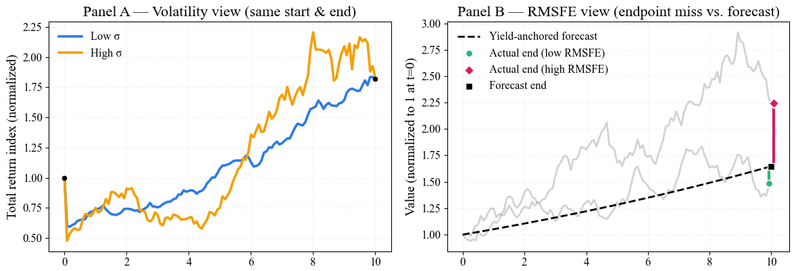
Forecast Error Is the Right Risk Metric for Long-Term, Hold-to-Maturity Investors
Traditional volatility (standard deviation of 1-year returns) exaggerates uncertainty for insurers, who reinvest and hold to maturity.
Root Mean Squared Forecast Error (RMSFE) captures the true risk: how far realized returns deviate from yield-based forecasts over 10 years.
1

Slide 8
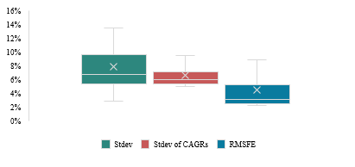



Volatility Is Not Long-Term Risk — RMSFE Captures What Actually Matters
RMSFE measures forecast error around the yield-based return anchor, bundling reinvestment and credit-loss risk — the core uncertainties insurers face.
Figure 5: Lower deviation in CAGRs compared to annual returns suggest mean reversion in returns, mainly driven by HY bonds, hybrids, and long-term indexes
$$σ_{\text{ann}}\left(10\right) = \sqrt{10} σ_{CAGR}\left(10\right)$$
$$σ_{1\text{y}}= {stdev}_{t}\left(R_{t,1\text{y}}\right)$$
$${RMSFE}_{\text{ann}}\left(10\right) = \sqrt{ {avg}_{t}[ε(t)]} × \sqrt{10}$$
1

Slide 9
Private Equity Delivers Equity Beta and Growth, But Net Alpha is Illusory
Private equity behaves like a leveraged small-cap equity strategy, with higher equity beta, modest real growth advantage, and limited evidence of persistent alpha after fees.
Illiquidity premia are often overstated: investors tolerate reduced transparency and volatility smoothing in exchange for headline stability, not economic compensation.
Expected returns are modeled using a DCF framework: income yield (~3.6%) plus real growth and modest multiple expansion, adjusted for leverage, fees, and long-term inflation to arrive at a 7.0% net nominal return.
y_{u} | g_{u} | r_{u} = y_{u} + g_{u} | D/E | k_{d} | r_{l} = r_{u} + (D/E)*(r_{u} - k_{d}) | m | r_{g} = r_{l} + m | f | r_{r} = r_{g} - f | i | r = r_{r} + i
Income Yield | Real Growth Rate | Real Unlevered Return | Debt to Equity | Real Cost of Debt | Real levered Return | Multiple Expansion | Gross Real ER | Fees | Net Expected Real Return | Expected Inflation | Net Expected Return
3.6% | + 3.0% | = 6.6% | 52.0% | 3.1% | 8.4% | + 0.3% | = 8.7% | -4.0% | = 4.7% | + 2.3% | = 7.0%
7

Slide 10
Private Credit Modeled as Levered High-Yield Exposure
Private credit return expectations are built from high-yield credit excess returns, scaled by a leverage multiplier (1.2×) and adjusted for inflation.
This approach yields an expected nominal return of ~7.3% (geometric) with lower variance than direct HY exposure, reflecting the risk/return profile of institutional private credit portfolios.
HY credit expected real return | Cash real return | HY credit excess real return | Leverage multiplier | Expected PC real return (arithmetic average) | Variance of levered HY credit return (L^2*Var(HY)) | Expected PC real return (geometric average) | Expected inflation | Expected PC nominal return (geometric average)
5.2% | 1.6% | 3.5% | 1.2 | 5.9% | 1.9% | 5.0% | 2.3% | 7.3%
For real estate, unlevered expected returns are anchored in net operating income (NOI) minus recurring capital expenditures, yielding a real free cashflow return of ~3.1%.
Real growth is assumed to be negligible over long horizons, resulting in a nominal unlevered return of ~5.4% after adding expected inflation.
NOI yield | CapEx (~NOI/3) | Cashflow yield | Real growth | Unlevered real ER | Expected inflation | Unlevered nominal ER
4.7% | - 1.6% | = 3.1% | + 0.0% | = 3.1% | + 2.3% | = 5.4%
8

Slide 11
Every Asset Modeled with Yield Anchors, Capital Charges, and Horizon-Aligned Risk
 | Asset | Schdl. | Rating | NAIC | Capital Charge | Mat. (year) | Dur. (year) | Starting Yield | ECL | Expected Return | ER (Cap-Adjusted) | StDev | Long-term Uncertainty | WA Risk
Government | US Treasuries, Short/Intermediate | D-1 | AAA | 1A | 0.00% | 4.0 | 3.7 | 3.83% | 0.00% | 3.83% | 3.83% | 6.01% | 2.93% | 3.86%
 | US Treasuries, Long | D-1 | AAA | 1A | 0.00% | 22.1 | 13.8 | 4.80% | 0.00% | 4.80% | 4.80% | 13.57% | 6.36% | 8.52%
 | US Taxable Munis | D-1 | AA | 1C | 0.00% | 13.3 | 10.6 | 3.96% | 0.10% | 3.86% | 3.86% | 8.21% | 2.41% | 4.15%
 | Global ex-US Government, hedged | D-1 | AA | 1C | 0.42% | 9.7 | 8.3 | 3.07% | 0.10% | 2.97% | 2.80% | 3.99% | 4.24% | 4.17%
Public Corporates | US Public Corporates IG AAA | D-1 | AAA | 1A | 0.16% | 5.4 | 5.0 | 4.23% | 0.00% | 4.23% | 4.16% | 4.45% | 2.29% | 2.94%
 | US Public Corporates IG AA | D-1 | AA | 1C | 0.42% | 7.8 | 6.8 | 4.36% | 0.10% | 4.26% | 4.09% | 5.48% | 2.45% | 3.36%
 | US Public Corporates IG A | D-1 | A | 1F | 0.82% | 10.3 | 8.3 | 4.87% | 0.07% | 4.80% | 4.48% | 6.27% | 2.82% | 3.85%
 | US Public Corporates IG BBB | D-1 | BBB | 2B | 1.52% | 10.5 | 8.2 | 5.21% | 0.49% | 4.72% | 4.11% | 7.23% | 3.20% | 4.41%
 | US Public Corporates, HY Intermediate | D-1 | BB– | 3C | 6.02% | 4.5 | 3.9 | 7.04% | 0.67% | 6.37% | 3.96% | 12.46% | 12.80% | 12.70%
 | US Public Corporates, HY Long | D-1 | BB– | 3C | 6.02% | 16.3 | 9.5 | 7.87% | 0.67% | 7.20% | 4.79% | 18.04% | 8.94% | 11.67%
 | Global ex-US Corporates, hedged | D-1 | A | 1F | 0.82% | 7.0 | 6.2 | 3.92% | 0.07% | 3.85% | 3.52% | 5.99% | 1.12% | 2.58%
Structured | Residential Mortgage-Backed Securities | D-1 | AA | 1C | 0.00% | 7.8 | 6.7 | 4.93% | 0.10% | 4.83% | 4.83% | 8.15% | 3.09% | 4.61%
 | Commercial Mortgage-Backed Securities | D-1 | AA | 1C | 0.00% | 4.4 | 4.1 | 4.69% | 0.10% | 4.59% | 4.59% | 7.74% | 3.69% | 4.90%
 | Asset-Backed Securities | D-1 | AA | 1C | 0.42% | 3.6 | 3.3 | 4.41% | 0.10% | 4.31% | 4.14% | 5.82% | 5.49% | 5.59%
Private Credit | Corporate IG Private Placement A | D-1 | A | 1F | 0.82% | 10.3 | 8.1 | 5.52% | 0.07% | 5.45% | 5.13% | 5.34% | 2.78% | 3.55%
 | Corporate IG Private Placement BBB | D-1 | BBB | 2B | 1.52% | 10.5 | 8.0 | 5.84% | 0.49% | 5.35% | 4.75% | 5.70% | 3.20% | 3.95%
 | Corporate HY Private (Leveraged Loans) | D-1 | B+ | 4A | 7.39% | 4.7 | 3.9 | 7.99% | 2.42% | 5.57% | 2.62% | 14.43% | 8.94% | 10.58%
 | Residential Mortgage Whole Loans | B | AA | 1C | 0.68% | 7.7 | 6.4 | 4.90% | 0.10% | 4.80% | 4.52% | 2.86% | 3.09% | 3.02%
 | Commercial Mortgage Whole Loans | B | AAA | 1A | 0.90% | 4.4 | 4.1 | 4.76% | 0.00% | 4.76% | 4.40% | 13.15% | 6.62% | 8.58%
Illiq. | Private Equity | BA | - | - | 30.00% | - | - | 6.98% |  | 6.98% | 3.98% | - | - | 25.27%
 | Real Estate (via partnerships, equity) | BA | - | - | 30.00% | - | - | 5.40% |  | 5.40% | 2.40% | - | - | 17.5%
1

Slide 12
Surplus-Aware Optimizer Simulates Liability-Aligned, Capital-Efficient Frontiers
Element | Summary
Objective | Maximize expected return net of surplus volatility and capital charge.
Key Formula | max (μᵀw − λ(wᵀΣw) − ϕ(cᵀw))
Risk Aversion (λ) | Controls penalty for surplus volatility.
Capital Penalty (ϕ) | Penalizes capital-intensive allocations using NAIC RBC charges.
Robustness | Monte Carlo resampling across 100 capital market scenarios.
Portfolio Constraints | Asset weights: 0%–10%, Credit quality ≥ A+, BBB ≤ 15%, below IG ≤ 5%
Strategic Asset Limits | Alt/Strategic Assets ≤ 35%, Real Estate ≤ 5%, Private Credit ≤ 20%
Liability Matching | Duration within ±1Y of liabilities, optional key-rate duration (KRD) matching active
Framework reflects realistic insurer constraints and surplus-driven logic, not internal allocation tools.
1

Slide 13
Simulating Surplus Under Macro Risk Reveals RMSFE Portfolios Are Superior
A multi-factor model links asset returns to macro variables (rates, curve, credit spreads, equities), estimating both regime-specific sensitivities and idiosyncratic risk.
Joint simulations of assets and liabilities over 10,000 macro scenarios show that portfolios built with RMSFE risk outperformed those built with volatility risk, especially in terms of long-term surplus stability.
RMSFE portfolios deliver higher median surplus growth, lower shortfall risk, and greater capital efficiency, thanks to better alignment with long-horizon liability dynamics and macro risk structure.
Company | Δ Surplus CAGR (RMSFE–VOL) | Δ P(Surplus<0) | Δ Surplus/RBC
Brighthouse | +0.10% | −2.3 pp | +0.13
Corebridge | +0.12% | −2.3 pp | +0.17
MetLife | +0.10% | −1.5 pp | +0.17
Principal | +0.13% | −2.2 pp | +0.16
Prudential | +0.11% | −1.9 pp | +0.15
Voya | +0.11% | −1.6 pp | +0.19
1

Slide 14
Appendix
1

Slide 15
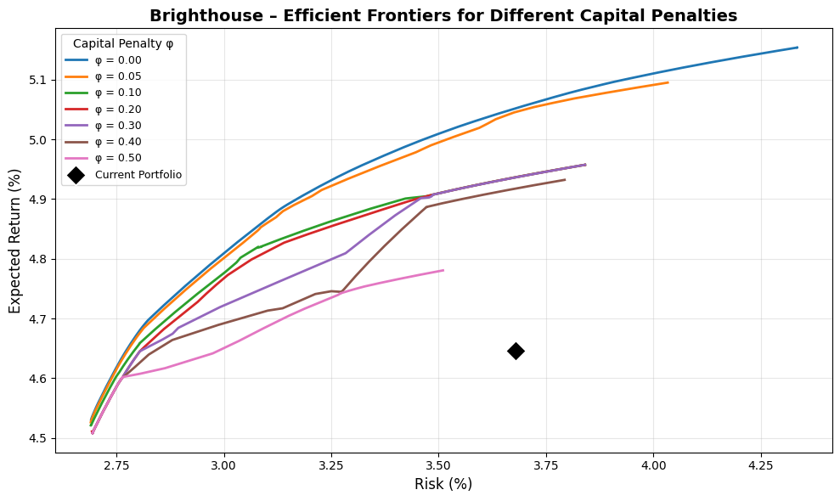
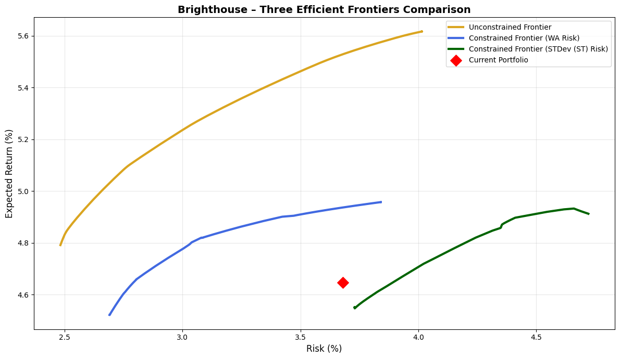
1

Slide 16
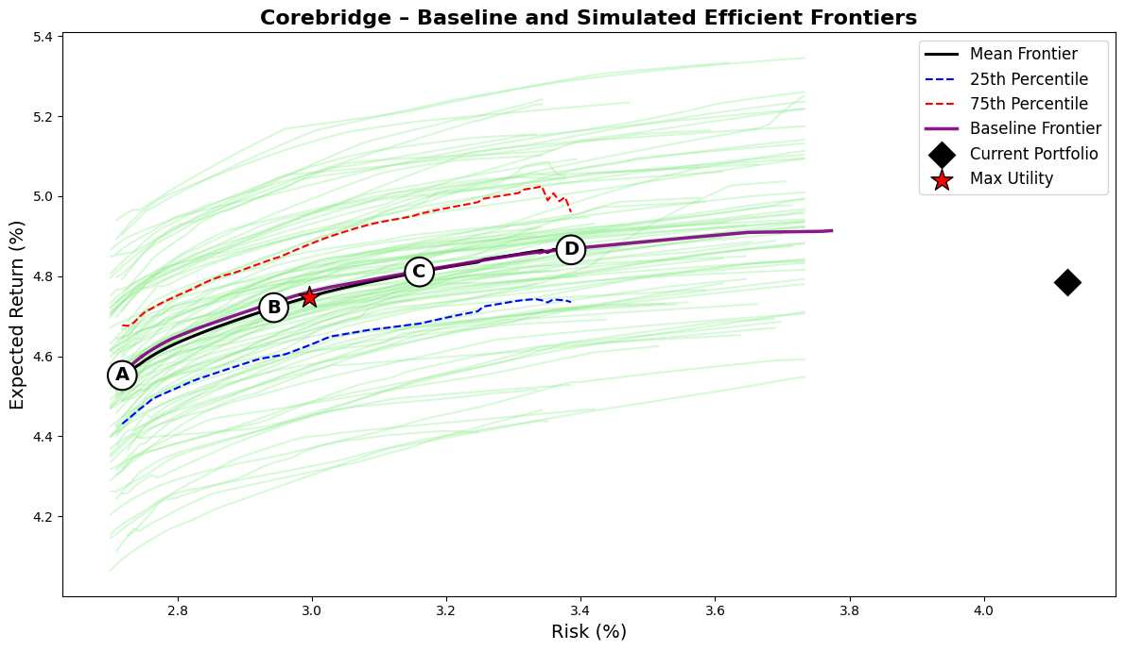
Corebridge’s Balanced Liabilities Enable Surplus Gains Through Spread Reallocation
The current portfolio is broadly sound but suboptimal: expected return remains flat while surplus volatility could drop by 120 bps, raising Sharpe from 0.19 to 0.24, without increasing capital usage or reducing duration alignment.
Efficiency gains come from trimming BBB corporates and commercial mortgage loans, reallocating toward structured products and private placements that offer higher return per unit of RBC, cutting capital use by over 50%.
Metric/Asset | Current | Max Utility
Expected Return (%) | 4.78 | 4.73
Risk (%) | 4.12 | 2.98
Sharpe Ratio | 0.19 | 0.24
Avg FI Credit Rating | A+ | AA-
FI Duration (years) | 6.18 | 6.52
Net Duration (years) | 0.58 | 0.92
Capital Use (%) | 1.72 | 0.75
US Treasuries, Short/Intermediate | 0.2 | 5.5
US Treasuries, Long | 0.3 | 0.9
US Taxable Munis | 1.9 | 0.3
Global ex-US Government, hedged | 1.8 | 0.0
US Public Corporates IG AAA | 2.8 | 9.9
US Public Corporates IG AA | 5.5 | 7.2
US Public Corporates IG A | 8.3 | 9.7
US Public Corporates IG BBB | 18.8 | 2.4
US Public Corporates, HY Intermediate | 1.3 | 0.4
US Public Corporates, HY Long | 1.6 | 2.3
Global ex-US Corporates, hedged | 0.0 | 8.0
Residential Mortgage-Backed Securities (RMBS) | 6.8 | 10.0
Commercial Mortgage-Backed Securities (CMBS) | 4.1 | 9.6
Asset-Backed Securities (ABS) | 12.8 | 3.1
Corporate IG Private Placement A | 4.5 | 10.0
Corporate IG Private Placement BBB | 5.1 | 10.0
Corporate HY Private (Leveraged Loans) | 0.8 | 0.5
Residential Mortgage Whole Loans | 5.5 | 10.0
Commercial Mortgage Whole Loans | 15.6 | 0.2
Private Equity | 2.5 | 0.0
Real Estate (via partnerships, equity) | 0.0 | 0.0
1

Slide 17
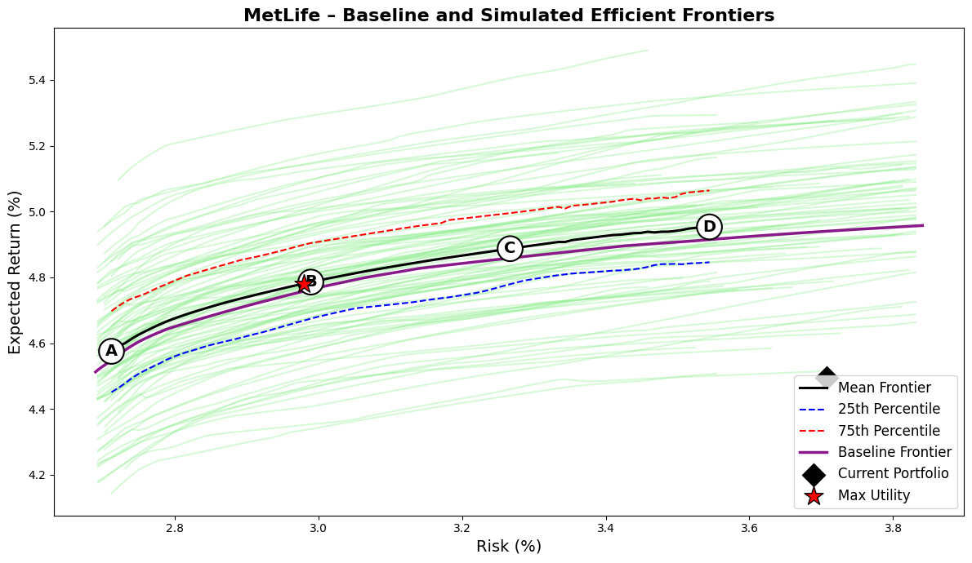
MetLife’s Global Allocation Leaves Room for Sharper, Capital-Efficient Rebalancing
The current portfolio underdelivers on risk-adjusted returns (Sharpe 0.13), with an opportunity to cut surplus volatility by 75 bps and lift Sharpe to 0.24 through reallocation—without sacrificing return or raising capital use.
Efficiency gains come from shifting out of capital-heavy global sovereigns and commercial whole loans into RBC-efficient spread assets like RMBS, CMBS, and private placements, reducing capital usage from 2.63% to 0.73%.
Metric/Asset | Current | Max Utility
Expected Return (%) | 4.50 | 4.71
Risk (%) | 3.71 | 2.97
Sharpe Ratio | 0.13 | 0.24
Avg FI Credit Rating | AA- | AA-
FI Duration (years) | 6.15 | 6.62
Net Duration (years) | -0.21 | 0.26
Capital Use (%) | 2.63 | 0.73
US Treasuries, Short/Intermediate | 4.0 | 4.5
US Treasuries, Long | 3.9 | 1.3
US Taxable Munis | 2.4 | 0.8
Global ex-US Government, hedged | 10.3 | 0.0
US Public Corporates IG AAA | 1.6 | 10.0
US Public Corporates IG AA | 3.2 | 7.5
US Public Corporates IG A | 4.8 | 9.8
US Public Corporates IG BBB | 3.8 | 3.1
US Public Corporates, HY Intermediate | 0.3 | 0.4
US Public Corporates, HY Long | 0.3 | 1.8
Global ex-US Corporates, hedged | 14.3 | 8.5
Residential Mortgage-Backed Securities (RMBS) | 9.9 | 9.9
Commercial Mortgage-Backed Securities (CMBS) | 2.3 | 9.2
Asset-Backed Securities (ABS) | 5.1 | 2.3
Corporate IG Private Placement A | 4.0 | 10.0
Corporate IG Private Placement BBB | 1.6 | 10.0
Corporate HY Private (Leveraged Loans) | 0.2 | 0.5
Residential Mortgage Whole Loans | 7.0 | 10.0
Commercial Mortgage Whole Loans | 14.0 | 0.4
Private Equity | 3.4 | 0.0
Real Estate (via partnerships, equity) | 3.4 | 0.0
1

Slide 18
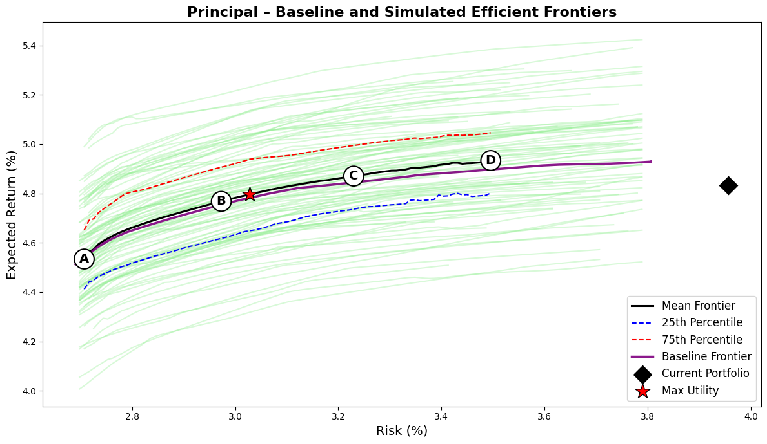
Principal Nears Efficiency Frontier, but Capital Optimization Unlocks More Surplus Stability
The current portfolio delivers a strong 4.83% return but carries nearly 1% excess surplus volatility relative to optimized portfolios that deliver the same return with just 3.02% risk.
Efficiency gains stem from reallocating out of BBB-rated public corporates and commercial mortgage whole loans into private placements, securitized credit, and long Treasuries, cutting capital use by ~70% while preserving return and duration alignment.
Metric/Asset | Current | Max Utility
Expected Return (%) | 4.83 | 4.74
Risk (%) | 3.96 | 3.02
Sharpe Ratio | 0.21 | 0.24
Avg FI Credit Rating | A+ | AA-
FI Duration (years) | 6.49 | 6.63
Net Duration (years) | 0.56 | 0.70
Capital Use (%) | 2.42 | 0.76
US Treasuries, Short/Intermediate | 0.7 | 4.4
US Treasuries, Long | 0.8 | 1.3
US Taxable Munis | 6.0 | 0.6
Global ex-US Government, hedged | 0.5 | 0.0
US Public Corporates IG AAA | 3.0 | 9.9
US Public Corporates IG AA | 4.5 | 8.0
US Public Corporates IG A | 9.0 | 9.9
US Public Corporates IG BBB | 19.4 | 2.5
US Public Corporates, HY Intermediate | 0.8 | 0.5
US Public Corporates, HY Long | 1.0 | 2.6
Global ex-US Corporates, hedged | 0.0 | 7.9
Residential Mortgage-Backed Securities (RMBS) | 3.6 | 9.9
Commercial Mortgage-Backed Securities (CMBS) | 5.0 | 9.3
Asset-Backed Securities (ABS) | 6.6 | 2.6
Corporate IG Private Placement A | 6.3 | 10.0
Corporate IG Private Placement BBB | 7.4 | 10.0
Corporate HY Private (Leveraged Loans) | 0.7 | 0.3
Residential Mortgage Whole Loans | 6.6 | 10.0
Commercial Mortgage Whole Loans | 13.2 | 0.3
Private Equity | 3.4 | 0.0
Real Estate (via partnerships, equity) | 1.7 | 0.0
1

Slide 19
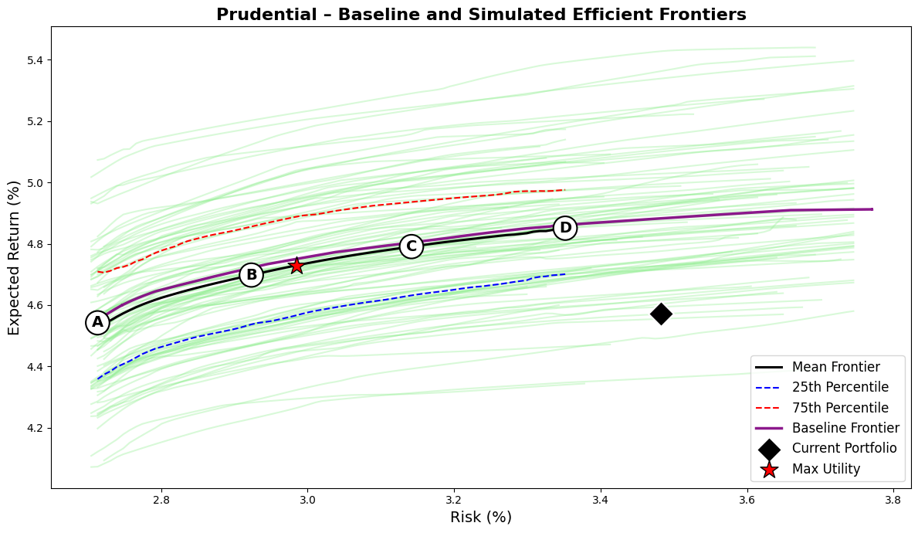
Prudential’s Book Nears Efficiency, but Global Sovereign Overweight Dulls Capital Potential
The current portfolio yields a solid 4.57% return but could reduce risk by 50–80 bps or add 20–25 bps of return through reallocations—mainly by trimming global sovereigns and reallocating to structured spread assets and private placements.
Optimized portfolios improve the Sharpe ratio from 0.16 to 0.24 and cut capital use by more than 50%, demonstrating that Prudential’s book is well-calibrated but still has room for refinement through higher-yielding, RBC-efficient sectors.
Metric/Asset | Current | Max Utility
Expected Return (%) | 4.57 | 4.72
Risk (%) | 3.48 | 2.97
Sharpe Ratio | 0.16 | 0.24
Avg FI Credit Rating | AA- | AA-
FI Duration (years) | 6.84 | 6.48
Net Duration (years) | 1.27 | 0.92
Capital Use (%) | 1.66 | 0.74
US Treasuries, Short/Intermediate | 2.5 | 5.6
US Treasuries, Long | 2.6 | 0.4
US Taxable Munis | 1.4 | 0.4
Global ex-US Government, hedged | 14.6 | 0.0
US Public Corporates IG AAA | 2.7 | 9.8
US Public Corporates IG AA | 5.4 | 7.4
US Public Corporates IG A | 8.2 | 9.9
US Public Corporates IG BBB | 7.7 | 2.4
US Public Corporates, HY Intermediate | 0.8 | 0.6
US Public Corporates, HY Long | 0.9 | 2.0
Global ex-US Corporates, hedged | 6.0 | 8.1
Residential Mortgage-Backed Securities (RMBS) | 1.0 | 10.0
Commercial Mortgage-Backed Securities (CMBS) | 2.4 | 9.5
Asset-Backed Securities (ABS) | 4.6 | 2.8
Corporate IG Private Placement A | 13.4 | 10.0
Corporate IG Private Placement BBB | 6.3 | 10.0
Corporate HY Private (Leveraged Loans) | 1.4 | 0.5
Residential Mortgage Whole Loans | 5.2 | 10.0
Commercial Mortgage Whole Loans | 10.4 | 0.6
Private Equity | 2.1 | 0.0
Real Estate (via partnerships, equity) | 0.5 | 0.0
1

Slide 20
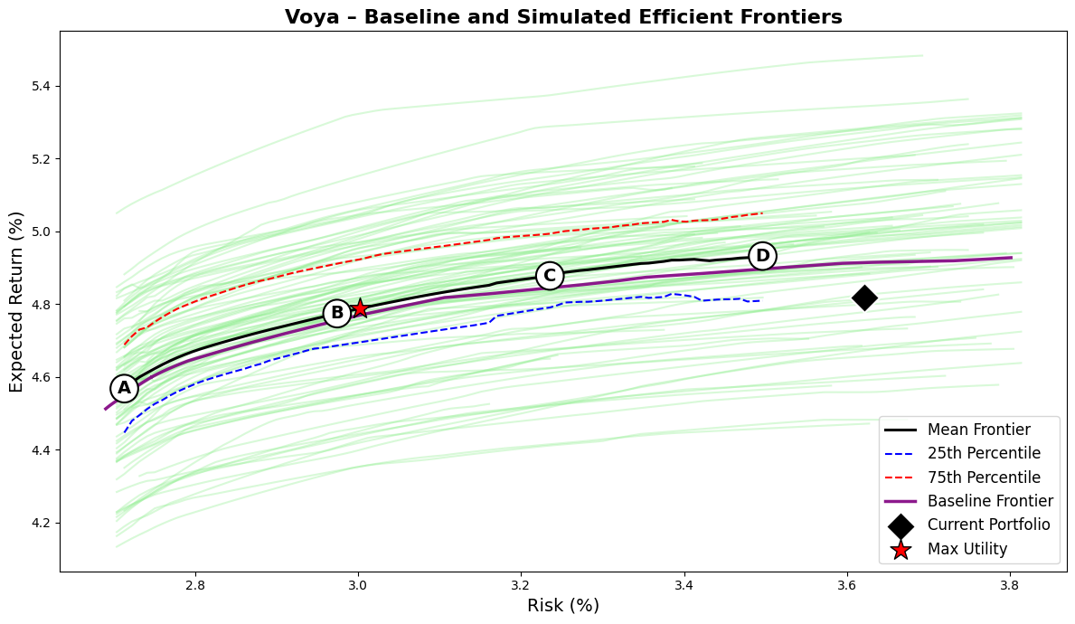
Voya’s Balances Liquidity and Efficiency, but Mortgage Overweight Dampens Potential
Voya’s current mix delivers 4.82% return at 3.62% risk, close to the efficient frontier but not fully optimal—surplus volatility could be cut by 60+ bps without sacrificing return by reallocating from commercial mortgages and BBB corporates to private placements and structured credit.
Optimized portfolios maintain credit quality (AA-) and liability alignment while reducing capital use from 2.16% to 0.73%, demonstrating that modest shifts toward capital-efficient spread sectors can significantly boost surplus efficiency.
Metric/Asset | Current | Max Utility
Expected Return (%) | 4.82 | 4.72
Risk (%) | 3.62 | 2.99
Sharpe Ratio | 0.23 | 0.24
Avg FI Credit Rating | AA- | AA-
FI Duration (years) | 6.20 | 6.65
Net Duration (years) | 0.31 | 0.76
Capital Use (%) | 2.16 | 0.73
US Treasuries, Short/Intermediate | 0.7 | 4.0
US Treasuries, Long | 0.9 | 1.4
US Taxable Munis | 1.4 | 0.8
Global ex-US Government, hedged | 3.4 | 0.0
US Public Corporates IG AAA | 1.4 | 9.8
US Public Corporates IG AA | 4.0 | 8.3
US Public Corporates IG A | 5.1 | 9.8
US Public Corporates IG BBB | 8.3 | 2.7
US Public Corporates, HY Intermediate | 0.5 | 0.4
US Public Corporates, HY Long | 0.6 | 2.0
Global ex-US Corporates, hedged | 6.8 | 8.1
Residential Mortgage-Backed Securities (RMBS) | 9.9 | 10.0
Commercial Mortgage-Backed Securities (CMBS) | 8.1 | 9.3
Asset-Backed Securities (ABS) | 7.9 | 2.7
Corporate IG Private Placement A | 11.6 | 10.0
Corporate IG Private Placement BBB | 9.2 | 10.0
Corporate HY Private (Leveraged Loans) | 1.2 | 0.3
Residential Mortgage Whole Loans | 4.9 | 10.0
Commercial Mortgage Whole Loans | 9.8 | 0.3
Private Equity | 4.5 | 0.0
Real Estate (via partnerships, equity) | 0.0 | 0.0
1

Slide 21
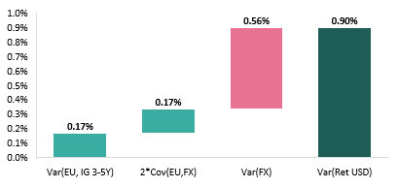
Cash and FX Risk Do Not Belong in Long-Term Strategic Allocation
Cash is excluded from return modeling due to its structural return deficiency, policy-driven volatility, and minimal long-term role in insurer portfolios; a fixed 1% allocation reflects its tactical liquidity function.
Foreign currency bonds are modeled using hedged indexes to strip out uncompensated FX volatility, aligning with institutional best practices that seek interest rate exposure, not currency noise.
Foreign currency volatility makes up the majority of the unhedged foreign currency bond risk
2

Slide 22

Covariance Matrix Built from Horizon-Matched Risks and Empirical Co-Movement
Risk inputs are custom volatility measures tailored to long-term economic exposures
Correlations are empirically estimated from excess returns of public proxies, then combined with custom σ via the covariance identity:
$${Cov}_{i,j}=ρ_{i,j}∗σ_{i}∗σ_{j}$$
US Treasuries, Short/Intermediate | 1.0 | 0.9 | 0.5 | 0.8 | 0.9 | 0.7 | 0.6 | 0.5 | 0.0 | 0.1 | 0.7 | 0.8 | 0.2 | 0.3 | 0.2 | 0.1 | -0.4 | 0.2 | 0.2 | 0.0 | 0.0
US Treasuries, Long | 0.9 | 1.0 | 0.6 | 0.8 | 0.9 | 0.8 | 0.6 | 0.5 | 0.0 | 0.1 | 0.7 | 0.8 | 0.2 | 0.3 | 0.2 | 0.2 | 0.3 | 0.2 | 0.2 | 0.0 | 0.0
US Taxable Munis | 0.5 | 0.6 | 1.0 | 0.7 | 0.7 | 0.7 | 0.7 | 0.7 | 0.5 | 0.5 | 0.6 | 0.7 | 0.4 | 0.6 | 0.3 | 0.3 | 0.2 | 0.5 | 0.4 | 0.0 | 0.0
Global ex-US Government, hedged | 0.8 | 0.8 | 0.7 | 1.0 | 0.8 | 0.8 | 0.7 | 0.6 | 0.2 | 0.3 | 1.0 | 0.8 | 0.3 | 0.3 | 0.3 | 0.2 | -0.1 | 0.4 | 0.3 | 0.0 | 0.0
US Public Corporates IG AAA | 0.9 | 0.9 | 0.7 | 0.8 | 1.0 | 0.9 | 0.7 | 0.6 | 0.2 | 0.3 | 0.6 | 0.9 | 0.4 | 0.4 | 0.3 | 0.2 | 0.4 | 0.5 | 0.4 | 0.0 | 0.0
US Public Corporates IG AA | 0.7 | 0.8 | 0.7 | 0.8 | 0.9 | 1.0 | 1.0 | 0.9 | 0.5 | 0.6 | 0.6 | 0.8 | 0.5 | 0.5 | 0.4 | 0.4 | 0.4 | 0.5 | 0.5 | 0.0 | 0.1
US Public Corporates IG A | 0.6 | 0.6 | 0.7 | 0.7 | 0.7 | 1.0 | 1.0 | 0.9 | 0.6 | 0.7 | 0.6 | 0.7 | 0.6 | 0.6 | 0.4 | 0.4 | 0.4 | 0.5 | 0.6 | 0.1 | 0.1
US Public Corporates IG BBB | 0.5 | 0.5 | 0.7 | 0.6 | 0.6 | 0.9 | 0.9 | 1.0 | 0.8 | 0.8 | 0.6 | 0.6 | 0.6 | 0.7 | 0.5 | 0.5 | 0.4 | 0.5 | 0.6 | 0.0 | 0.0
US Public Corporates, HY Intermediate | 0.0 | 0.0 | 0.5 | 0.2 | 0.2 | 0.5 | 0.6 | 0.8 | 1.0 | 0.9 | 0.2 | 0.3 | 0.7 | 0.6 | 0.5 | 0.5 | 0.8 | 0.5 | 0.7 | 0.0 | 0.1
US Public Corporates, HY Long | 0.1 | 0.1 | 0.5 | 0.3 | 0.3 | 0.6 | 0.7 | 0.8 | 0.9 | 1.0 | 0.2 | 0.4 | 0.7 | 0.6 | 0.5 | 0.5 | 0.8 | 0.5 | 0.7 | 0.0 | 0.1
Global ex-US Corporates, hedged | 0.7 | 0.7 | 0.6 | 1.0 | 0.6 | 0.6 | 0.6 | 0.6 | 0.2 | 0.2 | 1.0 | 0.7 | 0.7 | 0.7 | -0.1 | -0.1 | -0.1 | 0.4 | 0.4 | -0.2 | -0.2
Residential Mortgage-Backed Securities | 0.8 | 0.8 | 0.7 | 0.8 | 0.9 | 0.8 | 0.7 | 0.6 | 0.3 | 0.4 | 0.7 | 1.0 | 0.3 | 0.4 | 0.2 | 0.2 | 0.0 | 0.5 | 0.3 | 0.0 | 0.0
Commercial Mortgage-Backed Securities | 0.2 | 0.2 | 0.4 | 0.3 | 0.4 | 0.5 | 0.6 | 0.6 | 0.7 | 0.7 | 0.7 | 0.3 | 1.0 | 0.4 | 0.5 | 0.4 | 0.0 | 0.5 | 1.0 | 0.0 | 0.2
Asset-Backed Securities | 0.3 | 0.3 | 0.6 | 0.3 | 0.4 | 0.5 | 0.6 | 0.7 | 0.6 | 0.6 | 0.7 | 0.4 | 0.4 | 1.0 | 0.5 | 0.4 | 0.0 | 0.5 | 0.5 | 0.0 | 0.1
Corporate IG Private Placement A | 0.2 | 0.2 | 0.3 | 0.3 | 0.3 | 0.4 | 0.4 | 0.5 | 0.5 | 0.5 | -0.1 | 0.2 | 0.5 | 0.5 | 1.0 | 1.0 | 0.7 | 0.5 | 0.5 | 0.2 | 0.2
Corporate IG Private Placement BBB | 0.1 | 0.2 | 0.3 | 0.2 | 0.2 | 0.4 | 0.4 | 0.5 | 0.5 | 0.5 | -0.1 | 0.2 | 0.4 | 0.4 | 1.0 | 1.0 | 0.7 | 0.5 | 0.4 | 0.1 | 0.2
Corporate HY Private | -0.4 | 0.3 | 0.2 | -0.1 | 0.4 | 0.4 | 0.4 | 0.4 | 0.8 | 0.8 | -0.1 | 0.0 | 0.0 | 0.0 | 0.7 | 0.7 | 1.0 | 0.4 | 0.4 | 0.7 | 0.4
Residential Mortgage Whole Loans | 0.2 | 0.2 | 0.5 | 0.4 | 0.5 | 0.5 | 0.5 | 0.5 | 0.5 | 0.5 | 0.4 | 0.5 | 0.5 | 0.5 | 0.5 | 0.5 | 0.4 | 1.0 | 1.0 | 0.4 | 0.3
Commercial Mortgage Whole Loans | 0.2 | 0.2 | 0.4 | 0.3 | 0.4 | 0.5 | 0.6 | 0.6 | 0.7 | 0.7 | 0.4 | 0.3 | 1.0 | 0.5 | 0.5 | 0.4 | 0.4 | 1.0 | 1.0 | 0.0 | 0.2
Private Equity | 0.0 | 0.0 | 0.0 | 0.0 | 0.0 | 0.0 | 0.1 | 0.0 | 0.0 | 0.0 | -0.2 | 0.0 | 0.0 | 0.0 | 0.2 | 0.1 | 0.7 | 0.4 | 0.0 | 1.0 | 0.7
Real Estate (via partnerships, equity) | 0.0 | 0.0 | 0.0 | 0.0 | 0.0 | 0.1 | 0.1 | 0.0 | 0.1 | 0.1 | -0.2 | 0.0 | 0.2 | 0.1 | 0.2 | 0.2 | 0.4 | 0.3 | 0.2 | 0.7 | 1.0
10

Slide 23
Equity Returns Anchored in Shareholder Cash Flows, Not Earnings Noise
Public equity expected returns are built bottom-up using sector-level dividend and buyback yields, not accounting-based metrics.
Cash yield measures are more robust than earnings, as they are harder to manipulate and directly reflect shareholder payouts.
Buybacks now rival dividends in size and are essential to capturing the true return potential of U.S. large-cap equities.
Buyback yields have considerably increased since 2012
11

Slide 24
Valuation and Structural Signals Refine Equity Return Expectations
Implied equity risk premia (ERP) are derived via a two-stage DDM, solving for cost of equity at the sector level.
This multi-layer approach ensures forward-looking return estimates reflect real sector dynamics.
$$P = ∑_\{t=1\}^\{5\} [D₀(1+g)^t / (1+r)^t] + [D₀(1+g)^5(1+g_\{term\})] / [(r − g_\{term\})(1+r)^5]$$
Implied ERP levels have been more volatile in the last decade
12

Slide 25
Valuation & Margin Trends Refine Cash-Based Equity Return Forecasts
Implied equity risk premia (ERP) are refined using sector-specific CAPE regressions and long-term profitability trends to capture valuation mispricing and structural shifts.
Only sectors with strong CAPE-return relationships (R² > 0.2) received valuation adjustments; profitability trends were layered on top for sectors with meaningful structural margin shifts.
The relationship between CAPE signal and excess return has shifted but maintained strong negative relationship for Information Technology with twice as high R-squared. Blue dots represent time period 2009-2015, red dots are for 2015-2020, while black line represents the full sample.
The full explanation of the methodology can be found in the paper (full) version of this report.
13

